Slide 1
Lecture 12
Topics
Modular Design
Adder and Subtractor Design
Multiplier Design
ALU Design

Slide 2
Adders and Subtractors

Slide 3
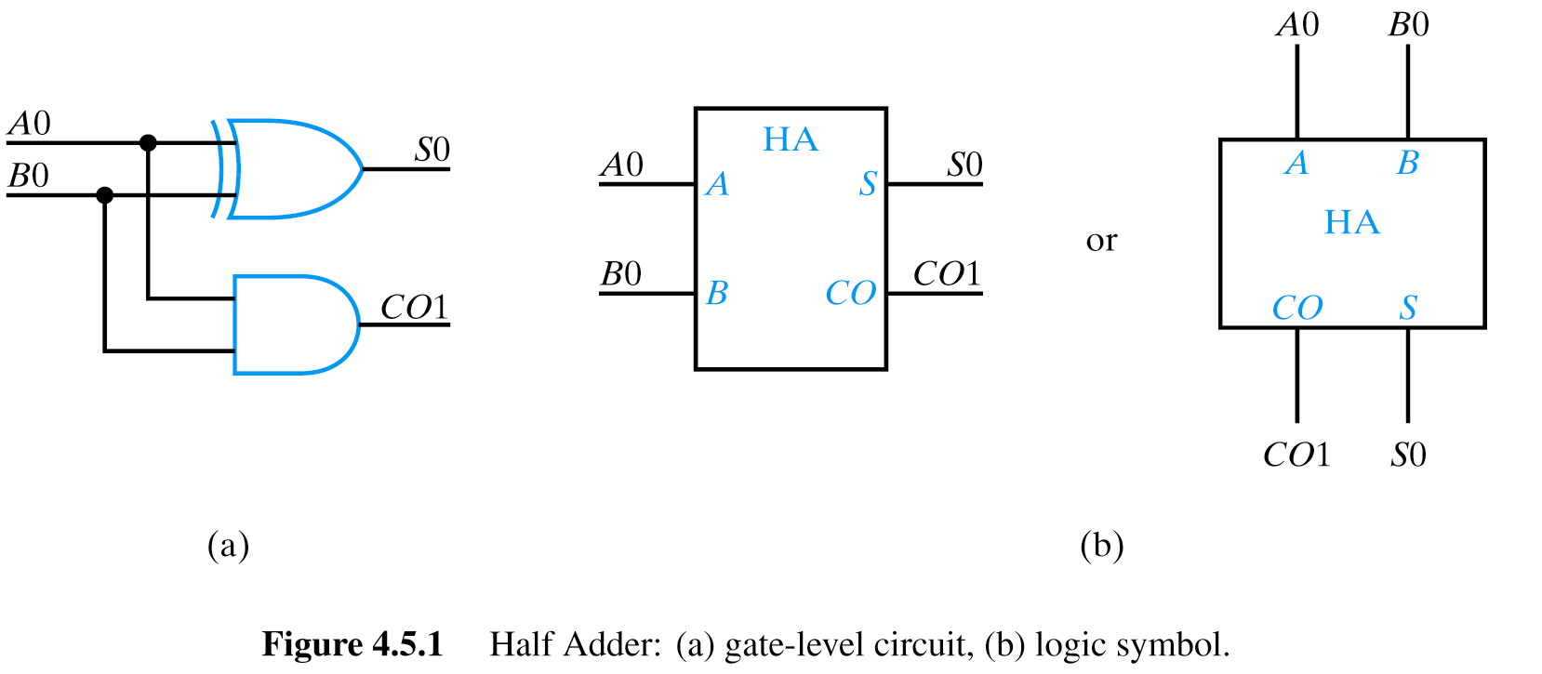
The Half Adder
A0
+ B0
CO1 S0
A0 B0 C01 S0
0 0 0 0
0 1 0 1
1 0 0 1
1 1 1 0

Slide 4
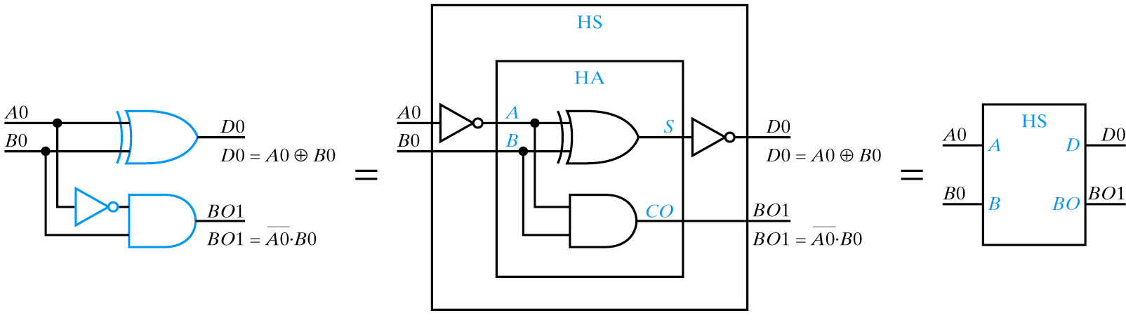
Half Subtractor
A0
- B0
BO1 D0
A0 B0 B01 D0
0 0 0 0
0 1 1 1
1 0 0 1
1 1 0 0
Contrast with Half Adder: same equation for D0! But BO1 and CO1 are different. Must complement A0. Can build HS from HA by
Inverting A0, then inverting S bit to correct.

Slide 5
The Full Adder
Consider a circuit to add two 4-bit numbers:
A3 A2 A1 A0
+ B3 B2 B1 B0
CO4 S3 S2 S1 S0
Truth table would have 8 inputs (2⁸ = 256 rows) and 5 outputs,
requiring 5 minimized functions (5 8-variable K-maps).
But operation at each bit position (after A0/B0) is identical:
CO_{i}
A_{i}
+ B_{i}
CO_{i+1} S_{i}
“bit slice”

Slide 6
Full Adder Truth Table
CI A B CO S
0 0 0 0 0
0 0 1 0 1
0 1 0 0 1
0 1 1 1 0
1 0 0 0 1
1 0 1 1 0
1 1 0 1 0
1 1 1 1 1

Slide 7
Ripple Carry Adders

Slide 8
Ripple Carry Adder
A1 A0
+ B1 B0
CO2 S1 S0

Slide 9
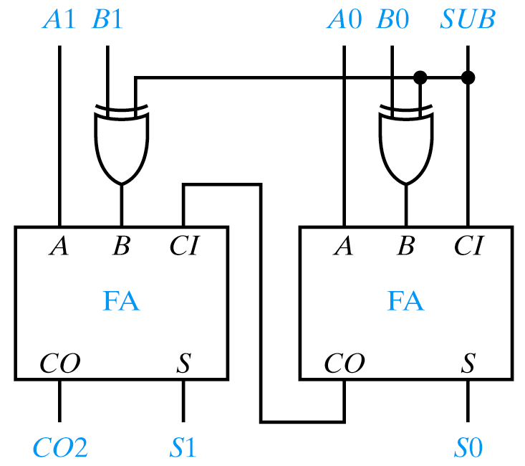
Modular Two Bit Adder/Subtractor
This is one of the reasons we choose 2s complement for representing negative numbers!
Increment and decrement
Increment: +1 (just use CI)
Decrement: -1 (use all 1s)

Slide 10
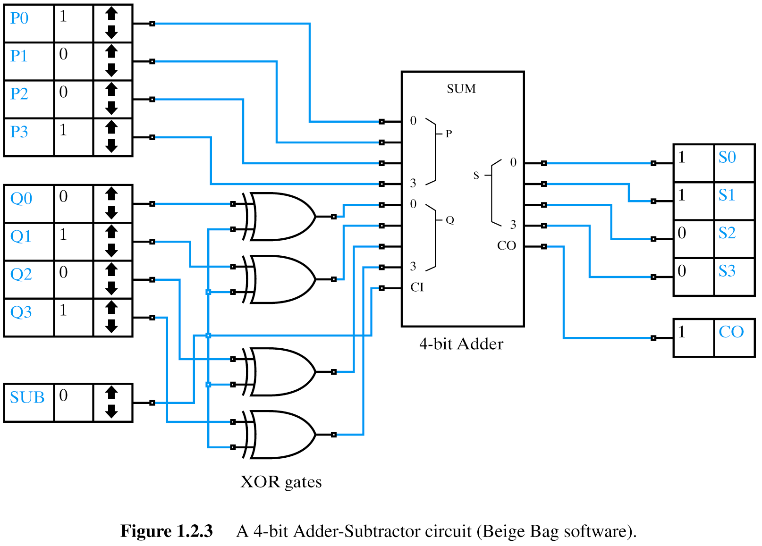
XOR Application: Twos Complement
4 bit adder/subtractor circuit from Chapter 1 showing XOR to form twos complement (RC)

Slide 11
Propagation Delay in Ripple Adder
Assuming S is
implemented using
AND, OR, NOT
S: T_{pd} = 3 t_{p}
CO: T_{pd} = 2 t_{p}
Can use HA for first bit and knock off 1 Tp

Slide 12
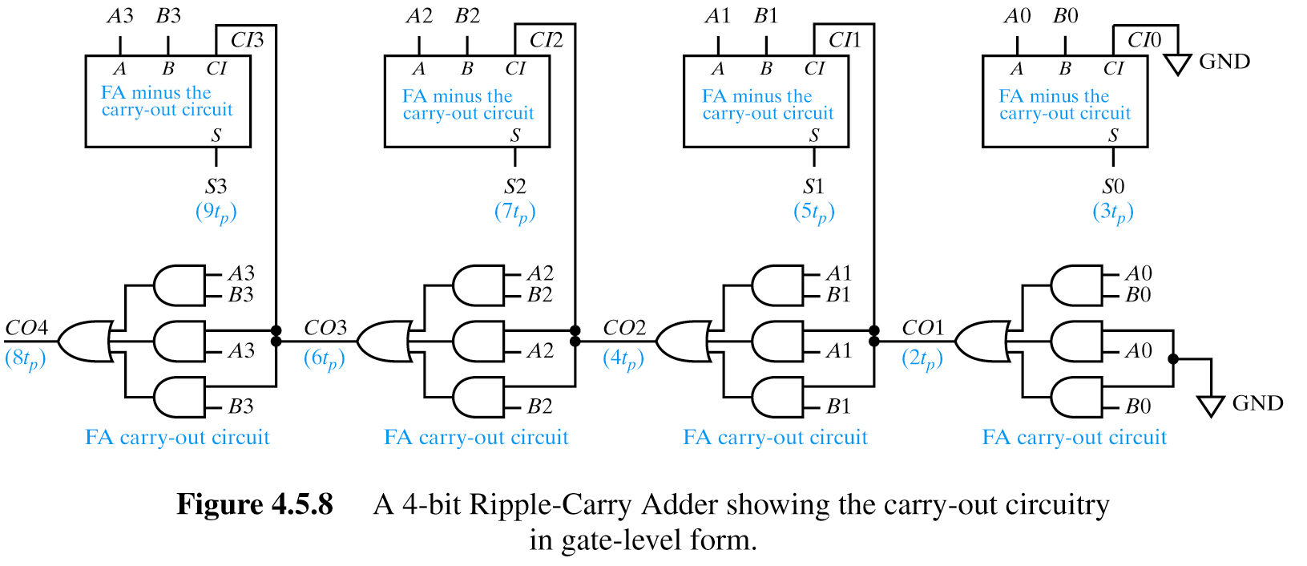
Partition Carry-Out Logic
Settling time for n stage ripple adder
ST = 3t_{p} + (n-1)(2t_{p}) = (2n+1)t_{p}
S of MSB stage
C of remaining earlier n-1 stages
Let’s look at what happens if we pull the carry-out portion of the logic out of the FA…
If we use HA the CO1 is computed by a single AND gate (Tp)

Slide 13
Using HA for LSB Stage
If we use HA for 1st stage (no CI)
ST = 3t_{p} + (n-2)(2t_{p}) + t_{p} = (2n)t_{p}

Slide 14
Carry Look Ahead Adders

Slide 15
Carry Look-Ahead Adder
Co_{n+1} logic not dependent upon entire prior stage (CO_{n}) logic

Slide 16
G (carry generate) is dependent upon current stage's ability to generate a carry.
P (carry propagate) is dependent upon current (and prior) stages’ ability to propagate a carry.
A carry is generated at a stage i if it is generated by stage i’s inputs (A_{i},B_{i}) or by any prior stage and propagated by every succeeding stage.
We can re-arrange the Cout equation, a defining G = A & B and P = A + B to get…
Intuitively, you can think of it in this way…
Alternatively, you can back substitute and observe that because we can generate all the P and G terms in one Tpd we are no longer dependent on Cout of previous stage

Slide 18
Carry Look-Ahead Adder
Co_{n+1} logic not dependent upon entire prior stage (CO_{n}) logic
Uses: G₀ through G_{n-1} and P₁ through P_{n-1}
Settling Time = 6t_{p} (constant) for 3 or more stages
Look closely at Tpd – not cumulative through the carry look-ahead part.
Doesn’t use previous carry-out stage

Slide 19
Speed Up Improvement
Ripple Carry Adder (n) Stages using HA for LSB
(2n)T_{p}
Carry Look-Ahead Adder (n) Stages (using SOP)
6T_{p}
Speed up for n stage adder
((2n)T_{p}-6T_{p})/(2nT_{p})
Assume T_{p} =1 and 4 stages:
(2 x 4 – 6)/(2 x 4)=
=2/8
=25%
Conclusion
Assuming Carry Look-Ahead we have 25% speedup for 4 stages

Slide 20
Speed Up Improvement
Ripple Carry Adder (n) Stages using HA for LSB
(2n)T_{p}
Carry Look-Ahead Adder (n) Stages (using SOP)
5T_{p}
Speed up for n stage adder
((2n)T_{p}-5T_{p})/(2n)T_{p})
Assume 4 stages
(2 x 4 – 5)/(2 x 4)
3/8
37.5%
changed
Conclusion
Assuming Carry Look-Ahead we have 37.5% speedup for 4 stages

Slide 21
Limits to Speed Up
Carry generation G₀ of first stage must be capable of driving all succeeding stages
Each succeeding stage requires gates with increasing number of inputs (fan-in)
Gate count increases with each stage

Slide 22
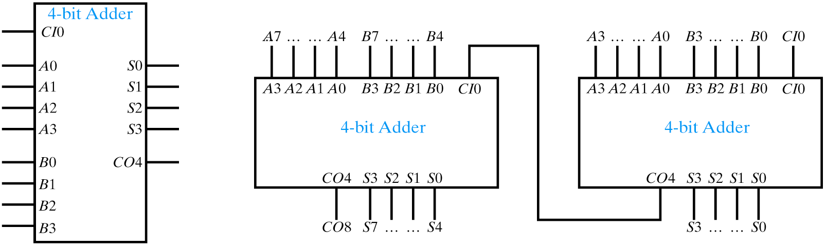
Expandable Carry Look-Ahead Adder
74LS83A & 74LS283
74LS83A: change slide after checking Wakerly? Actual device sum is 24ns and carry is 17 and gate equivalent description confirms 4 Tpd for Sum, 3Tpd for CO4. Carry look ahead used internally.

Slide 23
Wallace Trees

Slide 24
Carry-Save Adders (Wallace Tree Summing Network)
Adding more than two operands with full adders (A,B,CI,CO)
A0
B0
+ C0
S10
CO11
+ D0
S21 S20
CO21
+ E0
S31 S30
CO32 CO31
+ CO42_________
S42 S41 S40

Slide 25
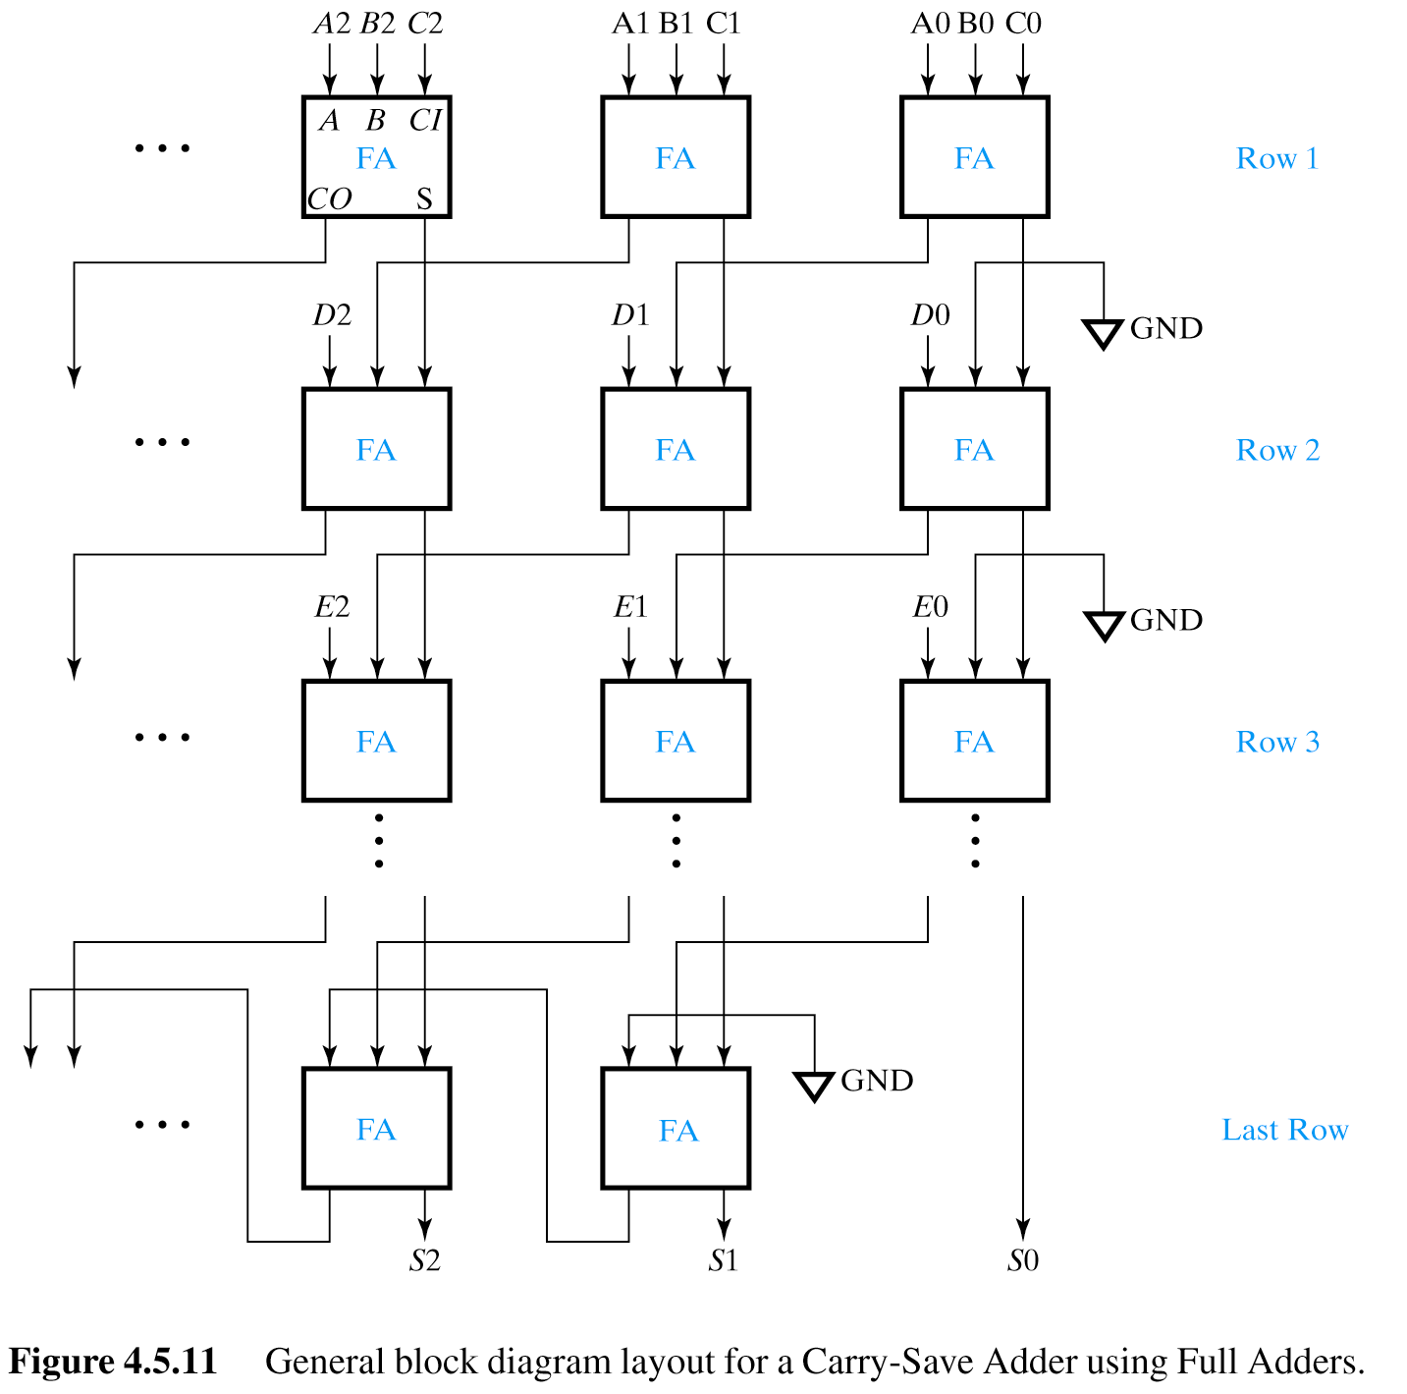
Carry-Save Adders

Slide 26
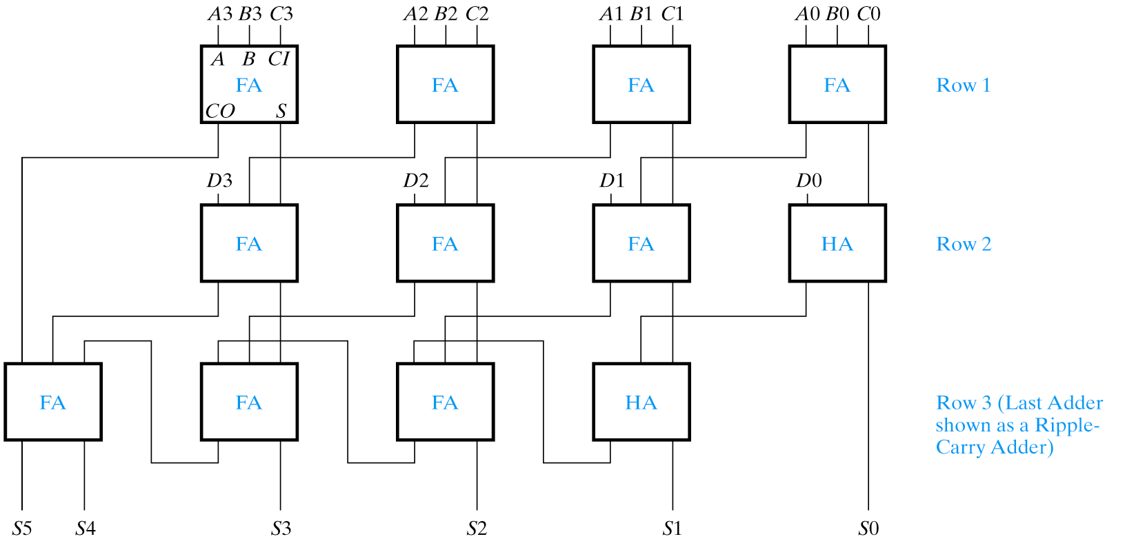

Slide 27
Multipliers

Slide 28
Multiplier Design
M x N bit multiplier requires M+N bit result: 2^{M} x 2^{N} = 2^{M+N}
Consider a 2-bit x 2-bit binary multiplier
11
x11
11
+ 11..
1001
multiplicand
multiplier
partial product 0
partial product 1
result
A0 B0 A0xB0 A0⋅B0
0 0 0 0
0 1 0 0
1 0 0 0
1 1 1 1
Truth tables quickly become unmanageable –use modular approach
Every partial product can be obtained from an AND operation
Use ripple or carry look-ahead adder to add two sets of partial products
Use carry save adder to add more than two sets of partial products

Slide 29
Example: 3-bit x 3-bit Multiplier Using Ripple Adders

Slide 30
Example: 3-bit x 3-bit Multiplier Using Ripple Adders
A2 A1 A0
x B2 B1 B0
P20 P10 P00
+ P21 P11 P01……..
S40 S30 S20 S10 S00
+ P22 P12 P02………………..
R5 R4 R3 R2 R1 R0
multiplicand
multiplier
partial product 0
partial product 1
partial sum 0
partial product 2
partial sum 1 (result)
Pmn = Am x Bn
9 partial products (9 AND gates)
2 rows of adders

Slide 31
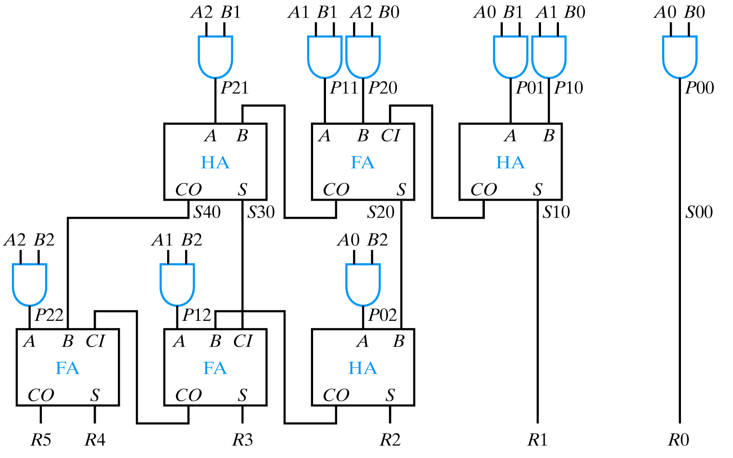
Multiplier Using Ripple Carry Adders

Slide 32
Pmn = Am x Bn
A2 A1 A0
x B2 B1 B0
P20 P10 P00
+ P21 P11 P01……..
S40 S30 S20 S10 S00
+ P22 P12 P02XXXXXXXX
R5 R4 R3 R2 R1 R0
multiplicand
multiplier
partial product 0
partial product 1
partial sum 0
partial product 2
partial sum 1 (result)
Using ripple carry adder

Slide 33
Example: 3-bit x 3-bit Multiplier Using Carry Save Adder

Slide 34
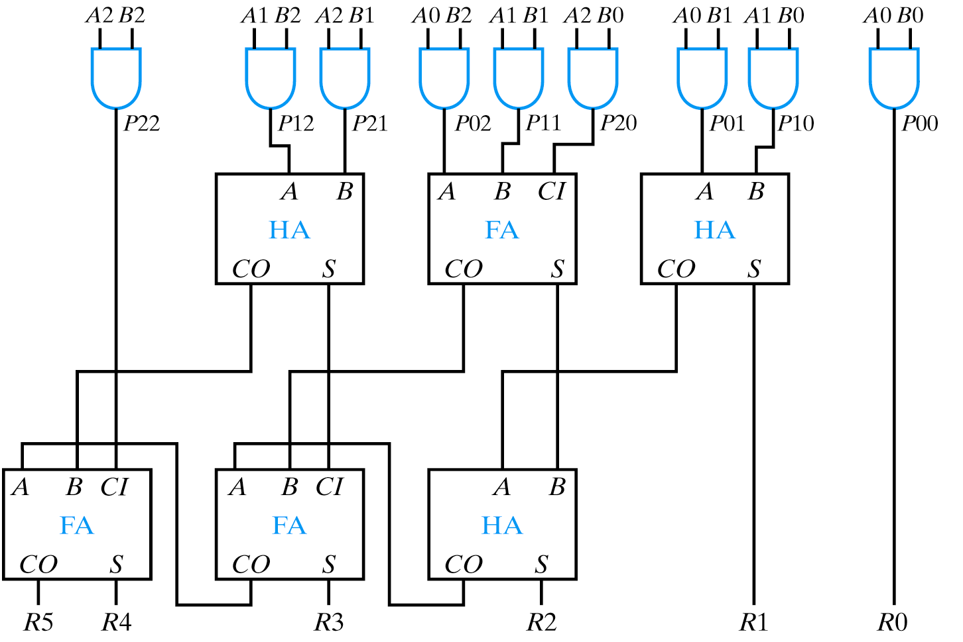
Multiplier Using Carry Save Adder
Can use the Wallace Summing Tree (Carry Save) Adder

Slide 35
ALUs – Arithmetic Logic Units

Slide 36
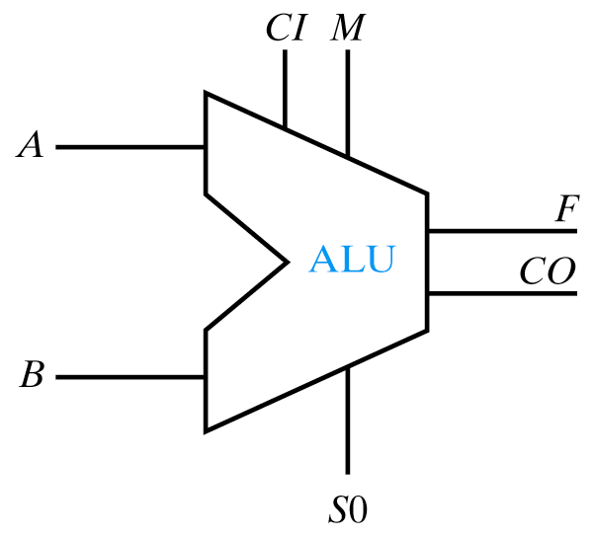
ALUs – Arithmetic Logic Units
Computational heart of a computer
M (mode) selects arithmetic or logic mode
S (select) selects operations
M S0 F and CO Comment
0 0 A+CI Increment A if CI == 1
0 1 A+B+CI Add A+B with carry
1 0 A OR B A OR B
1 1 A ⊕ B A XOR B
1-bit slice (because of CO, capable of being expanded)

Slide 37
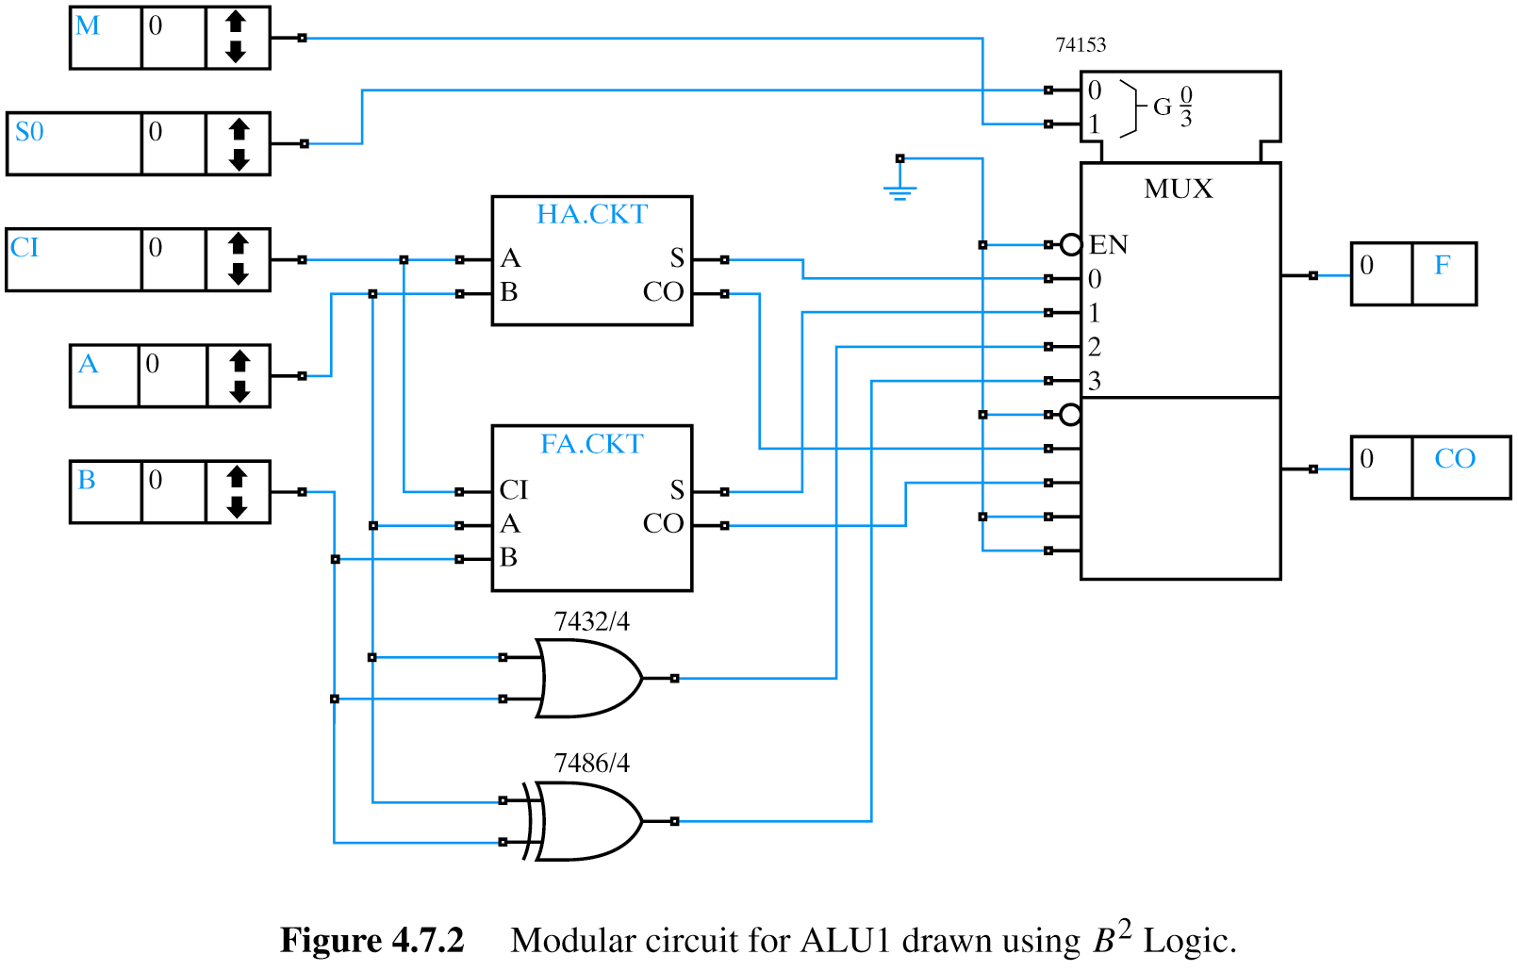
Modular ALU Implementation
M S0 F and CO
0 0 A+CI
0 1 A+B+CI
1 0 A OR B
1 1 A ⊕ B

Slide 38
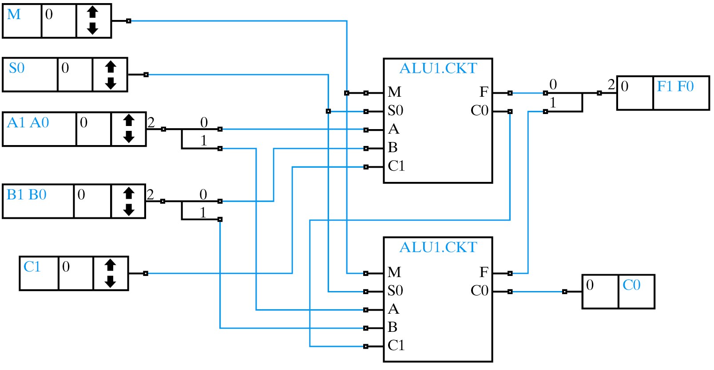
ALUs – Arithmetic Logic Units

Slide 39
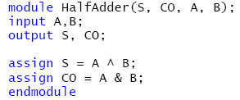
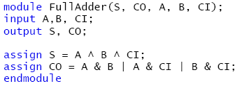
Hierarchical Implementation of 16-bit ALU

Slide 40
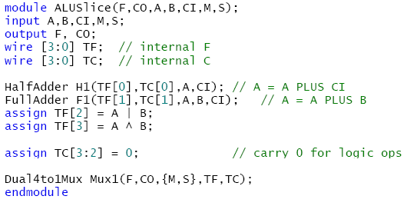
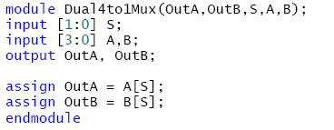
Hierarchical Implementation of 16-bit ALU

Slide 41
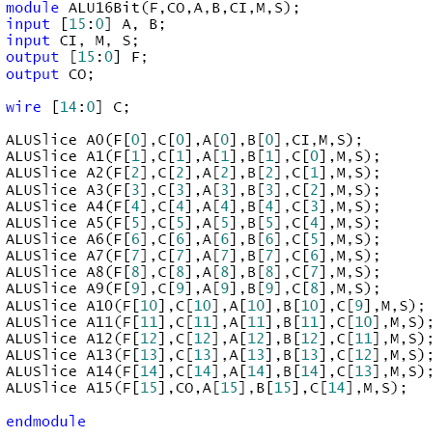
Hierarchical Implementation of 16-bit ALU
16
16
…

Slide 42
Still Better…
module ALUnBit(F,CO,A,B,CI,M,S);
parameter nBITS = 16;
input [nBITS-1:0] A,B;
input CI, M, S;
output [nBITS-1:0] F;
output CO;
wire C[nBITS:0];
genvar i;
assign C[0] = CI;
assign CO = C[nBITS];
generate
for (i=0; i < nBITS; i = i+1)
begin:ALU
ALUSlice m (F[i],C[i+1],A[i],B[i],C[i],M,S);
end
endgenerate
endmodule

Slide 43
Parameters
module ALUnBit(F,CO,A,B,CI,M,S);
parameter nBITS = 16;
input [nBITS-1:0] A,B;
input CI, M, S;
output [nBITS-1:0] F;
output CO;
wire C[nBITS:0];
genvar i;
assign C[0] = CI;
assign CO = C[nBITS];
generate
for (i=0; i < nBITS; i = i+1)
begin:ALU
ALUSlice m (F[i],C[i+1],A[i],B[i],C[i],M,S);
end
endgenerate
endmodule
module Processor(…);
ALUnBit ALUa (…)
ALUnBit #(32) ALUb (…);
.
.
.
ALUnBit #(64) ALUc (…);
endmodule
Creates three instances of ALUnBit – one using nBITS = 16 (default), another using nBITS = 32, and another using nBITS = 64
Can have multiple instances (each of different sizes)!

Slide 44
Parameters
module RAM(
clk , // Clock Input
address , // Address Input
data , // Data bi-directional
cs , // Chip Select
we , // Write Enable/Read Enable
oe // Output Enable
);
parameter DATA_WIDTH = 8 ;
parameter ADDR_WIDTH = 8 ;
parameter RAM_DEPTH = 1 << ADDR_WIDTH;
// Actual code of RAM here
endmodule
module RAMcontroller ();//Some ports
RAM #(.DATA_WIDTH(16),
.ADDR_WIDTH(8),
.RAM_DEPTH(256)) R1(clk,address,data,cs,we,oe);
endmodule

Slide 45
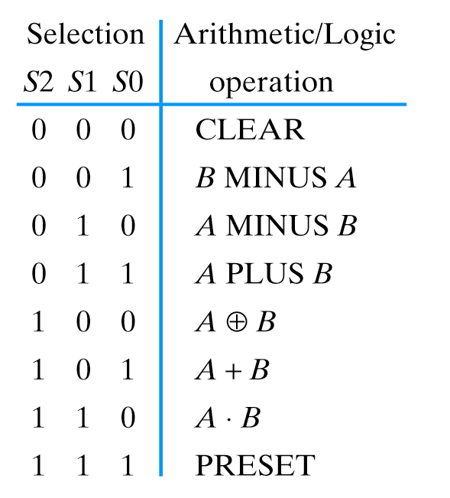
ALUs
32-bit ALU
Typical ALU Operations

Slide 46
Sources
Prof. Mark Faust
John Wakerly

